Slide 1

Assessment Agent
LLM Evaluation, Scoring & Automation
Presented by Karthik, Manoj, and Vamsi

Slide 2
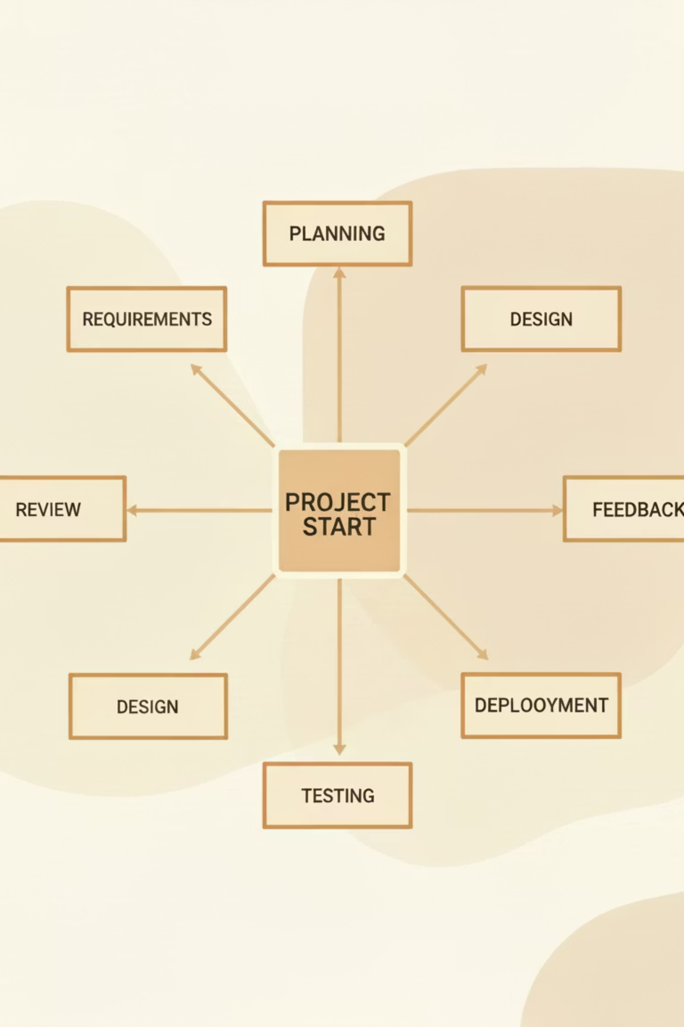
KARTHIK'S CONTRIBUTION
Project Planning & LLM Evaluation Strategy
Strategic Planning
Evaluation Framework
Defined comprehensive project plan and evaluation strategy to ensure systematic LLM testing and validation. Established the foundation for a Git-based workflow that supports continuous integration and prompt optimization.
Designed rigorous evaluation rules focused on reliability and consistency. Implemented a dynamic system allowing prompt updates based on evolving requirements without disrupting the core workflow.

Slide 3



KARTHIK'S CONTRIBUTION
Prompt Engineering Excellence
Response Consistency
Deterministic Scoring
Error Handling
Engineered prompts to deliver reliable, repeatable LLM outputs across diverse test scenarios and use cases.
Designed evaluation logic to ensure predictable scoring behavior, reducing variability in assessment results.
Developed robust mechanisms to manage edge cases and unexpected inputs, improving system resilience.
Continuous refinement of prompts ensures adaptability for future requirements while maintaining backward compatibility with existing evaluation workflows.

Slide 4

MANOJ'S CONTRIBUTION
Assignment Data Architecture
Complete Data Storage
Implemented comprehensive database solution to store all assignment details, ensuring data persistence and accessibility throughout the evaluation lifecycle.
Optimized Scoring Logic
Modified and enhanced scoring algorithms to improve accuracy and performance. Focused on data consistency and integrity across all evaluation stages.
Enhanced Reliability
Built safeguards to ensure evaluation results remain consistent and trustworthy, even under high-volume processing scenarios.

Slide 5



MANOJ'S CONTRIBUTION
Three-Stage Evaluation Pipeline
Stage 1: Scoring
Initial evaluation phase where responses are assessed against defined criteria and rubrics.
Stage 2: Question-wise Analysis
Granular evaluation of individual questions, providing detailed feedback and insights per question.
Stage 3: LLM Response Processing
Gemini AI integration handles JSON response parsing and final result compilation with high accuracy.
This modular approach improves evaluation accuracy, reduces ambiguity, and enhances system maintainability for future scaling needs.

Slide 6
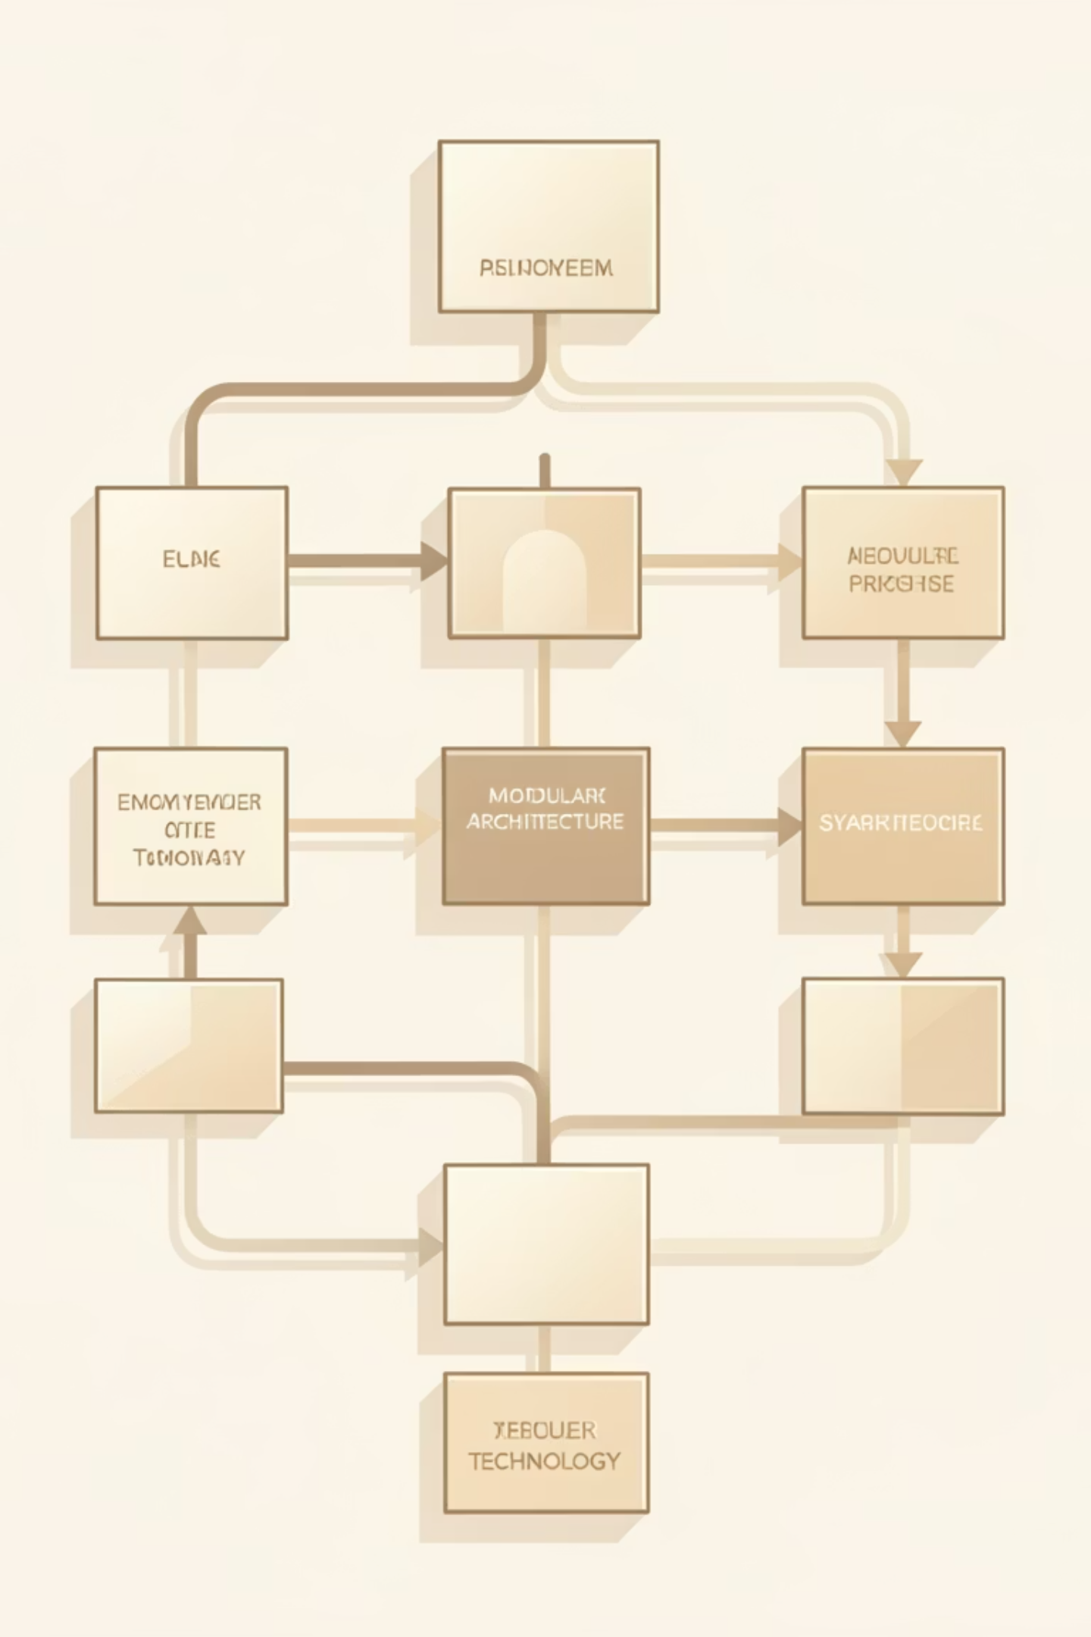
Pipeline Architecture Benefits
—
—
—
Faster Debugging
Clarity Improvement
Reduced Ambiguity
Improved separation of concerns enables rapid identification and resolution of issues.
Enhanced scoring transparency provides stakeholders with clear evaluation insights.
Structured pipeline minimizes interpretation errors and evaluation inconsistencies.

Slide 7

VAMSI'S CONTRIBUTION
GitHub Automation & Workflow Optimization
Automated Repository Management
Developed automation scripts to seamlessly clone GitHub repositories to local systems, eliminating manual setup effort and accelerating developer onboarding.
Streamlined Execution
The automation enables smooth evaluation pipeline execution from repository initialization through final scoring, reducing setup time from hours to minutes.

Slide 8



VAMSI'S CONTRIBUTION
Three-Layer System Architecture
Input Layer
1
Data collection and preprocessing
Evaluation Logic Layer
2
Core assessment algorithms and LLM integration
Scoring & Output Layer
3
Result compilation and reporting
This architectural approach improves modularity, enhances testing capabilities, and supports scalable future development. Each layer operates independently while maintaining seamless integration.

Slide 9

VAMSI'S CONTRIBUTION
Test Agent & Validation Framework
01
02
03
Partial Scoring Implementation
Test Agent Development
Early Detection System
Developed foundational logic for scoring mechanism, enabling accurate assessment of partial correctness in student submissions.
Built comprehensive test agent for validation and verification of scoring behavior across diverse scenarios and edge cases.
Established testing framework that identifies edge cases and potential issues early in the development cycle, reducing production defects.

Slide 10

Project Impact & Future Vision
Key Achievements
Looking Ahead
Accurate and consistent LLM-based evaluation system
Enhanced scalability for larger assignment volumes
Robust three-stage pipeline with modular architecture
Advanced prompt engineering capabilities
Automated workflows reducing manual effort
Expanded testing and validation coverage
Strong collaborative foundation across team members
Continuous improvement based on user feedback
Questions & Discussion

